Slide 1
B-350 2020-21 Summary
Presented by Kiyannah Joyner MBA, CIA, CFE, CRMA
March 24, 2022

Slide 2
Background
Revised BPRM B-350 Governmental Internal Control and Internal Audit Requirements was issued on March 18, 2018.
Changed the Internal Control Certification and Internal Audit Evaluation forms.
Archived the Budget Bulletin B-1222.
Added the Internal Control Compliance Report.
Submission date is always
April 30

Slide 3
Submission Overview
Agencies Reporting:
Full Compliance
36
Partial Compliance
12
13 Agencies
Average Submission Date
April 29
Average Days Late
52

Slide 4
* There were 59 agencies required in 2019-20 to submit the B-350 and 60 agencies in 2020-21

Slide 5
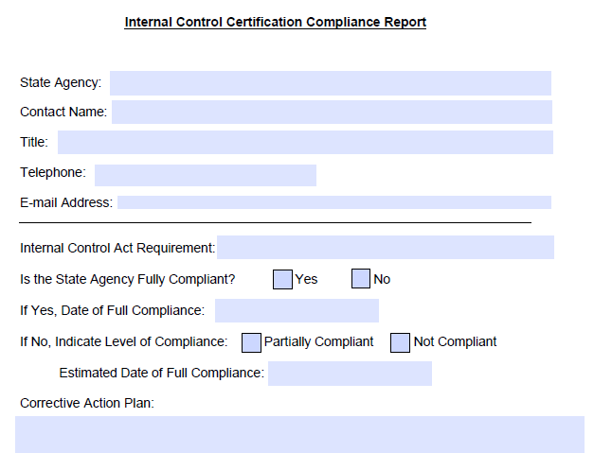
Internal Control Compliance Report
Form is used for two purposes:
  Tracking Agency efforts to reach full compliance – all requirements certified as partial or not compliant must provide a corrective action plan and estimated date of full compliance. This Report is sent to DOB on the provided date of full compliance.
  Acquiring additional information for Certification responses lacking in detail.

Slide 6
Why are we not Fully Compliant?
Common Problems Addressed in Submissions
Internal Control Act Requirement | Full Compliance | Partial Compliance
Requirement 1 | 47 | 1
Requirement 2 | 45 | 3
Requirement 3 | 44 | 4
Requirement 4 | 48 | 0
Requirement 5 | 47 | 1
Requirement 6 | 41 | 7
Obtaining required number of CPE’s each year per staff member.
IT upgrades and implementation of services that take time away from IC processes and increase risk.
Unable to complete an independent Quality Assurance Review in the last five years.
Revising and updating all policies and procedures
Vacancies in ICO or DIA positions.
Notes:
I am imagining the presenter going through each of the word bubbles:
DOB is working on a free day of training, for CPEs, that is directed towards new to mid-level audit and internal control staff
It is critical that agencies try to mitigate as many risks as possible for IT upgrades and implementations
QAR – discuss the “self-review” idea being tossed around, round robins, urge DIAs to reach out to their staff and counterparts at other agencies for individuals certified to complete a QAR
Revising procedures should be an agency-wide process and consistently looked at (Both State internships I had, my first job was to update the policies)
ICO and DIA vacancies – This is an acceptable reason for partial compliance. If there is assistance DOB can provide, we are happy to help.

Slide 7
Internal Control Act Requirements Reference Guide
1) Establish and maintain guidelines for a system of internal controls for the agency.
State the agency head’s support of internal controls.
Describe the process for evaluating internal controls.
2) Establish and maintain a system of internal controls and a program of internal control review for the agency.
Evaluate effectiveness of internal control system.
Incorporate 2013 COSO Framework into the system.
3) Make available to each officer and employee of the agency a clear and concise statement of the generally applicable management policies and standards with which the officer or employee of such agency is expected to comply, along with detailed policies and procedures the employees are expected to adhere to in completing their work.
Set clear expectations from agency management in the statement.
Issue periodically and emphasize the importance of effective internal controls.
5) Implement education and training efforts to ensure that officers and employees have achieved adequate awareness and understanding of internal control standards and, as appropriate, evaluation techniques.
Identify staff requiring internal control training.
6) Periodically evaluate the need to establish, maintain or modify an internal audit (IA) function.
Define responsibilities of agency management and staff.
Institute policy for documenting and reporting deficiencies in system.
Provide employees with applicable policies and procedures for their position.
DOB establishes list of agencies required to have an internal audit function.
4) Designate an Internal Control Officer (ICO), who reports to the agency head, to implement and review the internal control responsibilities established pursuant to this BPRM item.
Coordinates internal control activates.
Ensures activates meet requirements of the B-0350.
Evaluates adequacy of internal control reviews.
Implement on-going and specific training to agency staff.
Internal Audit unit is required to be managed by a Director of Internal Audit (DIA).
The DIA reports directly to the agency head.

Slide 8
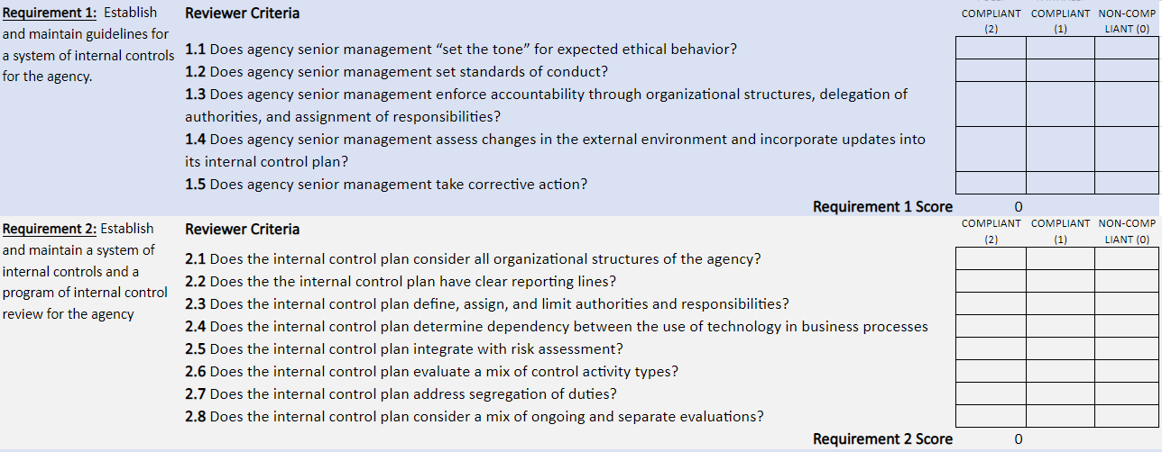
Scorecard Evaluation on Requirements
Agency submission are reviewed and evaluated based on criteria for each Requirement.
Requirements are subject to subset of questions unique to each requirement for reviewer to evaluate.
Agency certifications were used during CRF expense review
DOB will continue to use these results to inform risk assessments related to Federal funding
Notes:
Questions needing Answers:
1) What are minimum values for a single Requirement to achieve a Full Compliance?
2) Are any Requirements weighed heavier if there are more subset questions within differing Requirements?
3) Does Partial compliance in subset question affect ability to achieve Full Compliance in a single Requirement ?
4) Is there an overall number needed to achieve Overall full compliance?

Slide 9
Requirement 2: Internal Control Review
Major Agency
Review begins with Program Units reviewing the list of their current program functions, generated from a computerized database, that identifies those scheduled for testing and outstanding corrective action plans.
Program Units perform risk assessments, document key internal controls, control objectives, and testing methods of all functions. Then the methods are used to test the effectiveness of preselected functions. If testing revealed deficiencies, corrective action plans are created and implemented.
When testing is complete, upper management review and certify the results. All collected information is recorded in the Internal Control Database. Statistical analysis is performed through the database to yield status of agency’s internal controls.
Minor Agency
This Agency follows a six-step documented review:
Each program area reviews and updates their inventory of major functions or services;
A risk assessment is completed for selected major functions.
For each identified risk, an “Internal Control Risk Questionnaire” form is completed;
“Internal Control Review Worksheets” are completed to document any testing relating to the questionnaire;
“Corrective Action Planning Questionnaires” and “Corrective Action Plan Worksheets” must be completed when a risk is identified with control deficiencies.
The ICO and liaisons facilitate this review and ensure step completion.
Notes:
I chose to add this slide on Requirement 2 because it is the most partially compliant by a large percentage. The two weak areas were the Review and the Risk Assessment. I thought it would be cool to include two samples of responses for the Review and the Risk Assessment.
Requirement 2 because that was the most Partially Compliant response. I chose to highlight OGS’ review process for “Major” Agency and DHSES for “Minor”
I am using Major and Minor agencies as defined by DOB and can be found here: https://www.budget.ny.gov/pubs/archive/fy20/enac/fy20fp-en.pdf

Slide 10
Requirement 2: Risk Assessment
The NYSICA website has a PowerPoint on Risk Assessment and can be found here.
Outlined below are unique practices included in some submissions:
Major Agency
Established a Risk Assessment and Mitigation Committee that reviews enterprise-wide risks
Created an Internal Control Database that holds all inputted data and can produce statistical analyses
Utilizes the required completion of worksheets and matrices that are electronically submitted to ICO for evaluation
Holds meetings between Program Staff and an Enterprise Risk Management Bureau to analyze potential impacts of each identified risk
Minor Agency
Program Managers complete a Vulnerability Self-Assessment and determine a vulnerability score for each assessable unit function
Created a Risk Management Database that aids risk-ranking and testing sequences
Utilizes Risk Matrix templates all Division Directors are required to complete
Circulates an electronic Internal Control Survey through SurveyMonkey to Division Heads

Slide 11
Reaching Fully Compliant
The following resources are available to all State Agencies to assist in achieving full compliance in their Internal Control Certifications
DOB
BPU (Audit and Internal Control Staff) is happy to answer questions and help in any possible way
DOB Online is home to the B-350 and other Internal Control procedures
Internal Control Mailbox- dob.sm.icreporting@budget.ny.gov
NYSICA
Website contains many documents, PowerPoints, links to other resources
Hosts many forums, presentations and workshops
OSC
Publishes many documents related to Internal Controls and Internal Audit in New York State Agencies, Authorities and other entities
Internal Control Task Force website found here
We encourage discussion between your counterpart ICOs of other Agencies.

Slide 12
Questions?
Kiyannah Joyner
Kiyannah.Joyner@budget.ny.gov
518-473-0411

